Slide 1
The Generative AI Ecosystem 50k User Reviews 2026 predictions

Slide 2
INTRODUCTION
Online platforms generate large volumes of user reviews
Reviews contain valuable insights about user experience
Manual analysis of reviews is time-consuming and inefficient
Machine Learning helps automate text analysis
Text data is converted into numerical form using techniques like TF-IDF
Models can learn patterns from reviews to predict ratings
This project predicts star ratings (1–5) from review text
Uses multiple models: Logistic Regression, Decision Tree, and XGBoost
Includes an interactive interface using Gradio for real-time predictions

Slide 3
objectives
To analyze user review text using Machine Learning
To convert textual data into numerical features using TF-IDF
To build and train multiple classification models
To compare performance of:
Logistic Regression
Decision Tree
XGBoost
To evaluate models using accuracy and classification metrics
To identify the best-performing model
To develop an interactive system using Gradio
To enable real-time prediction of star ratings from user input

Slide 4
KEY CONCEPTS
Machine Learning: Learning patterns from data to make predictions
Supervised Learning: Uses labeled data (reviews + ratings)
TF-IDF: Converts text into numerical features
Classification: Predicting star ratings (1–5)
Models Used: Logistic Regression, Decision Tree, XGBoost
Evaluation Metrics: Accuracy, Precision, Recall, F1-score
Gradio: Interface for real-time predictions

Slide 5
PROCESS OF DATASET
Collected dataset containing user reviews and star ratings
Selected relevant columns:
Review_Text
Star_Rating
Handled data preprocessing and cleaning
Converted text data into numerical form using TF-IDF
Encoded target labels (ratings) using Label Encoding
Split dataset into:
80% Training data
20% Testing data
Used processed data to train and evaluate models

Slide 6
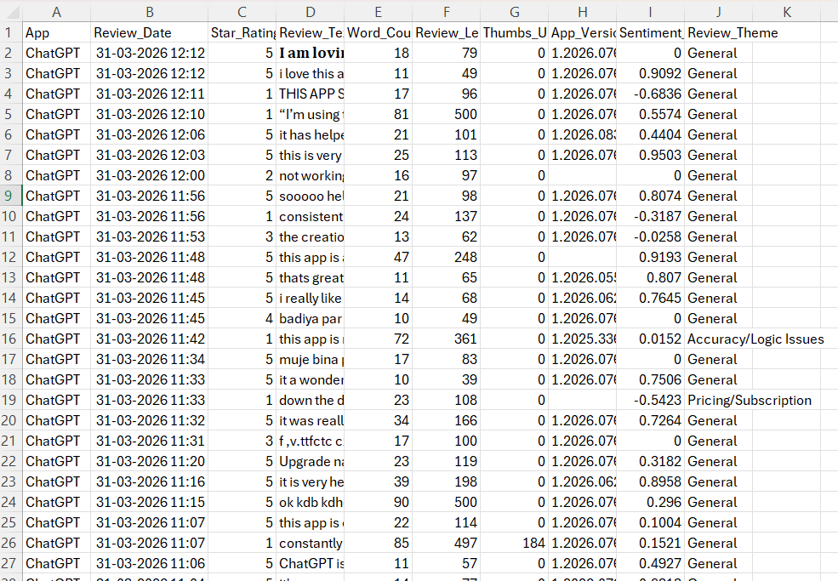
DATASET USED

Slide 7
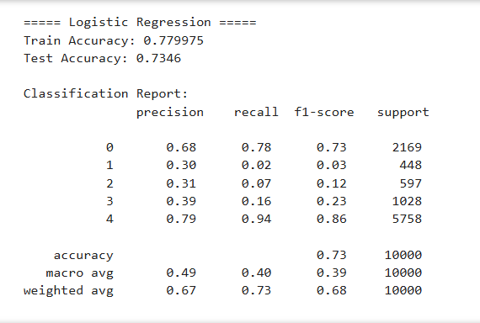
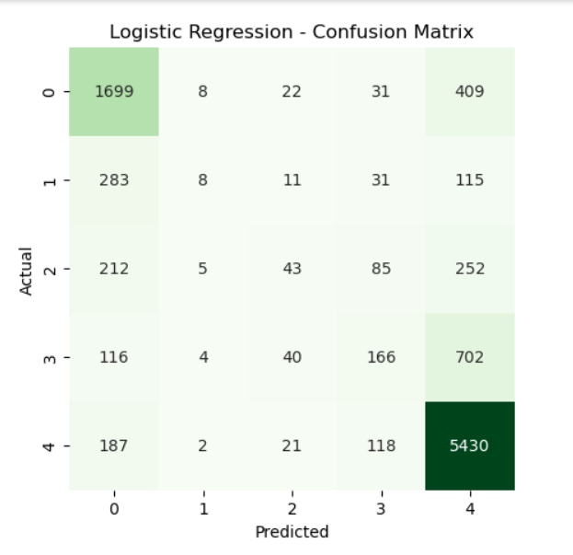
MODEL EVALUATION – LOGISTIC REGRESSION

Slide 8
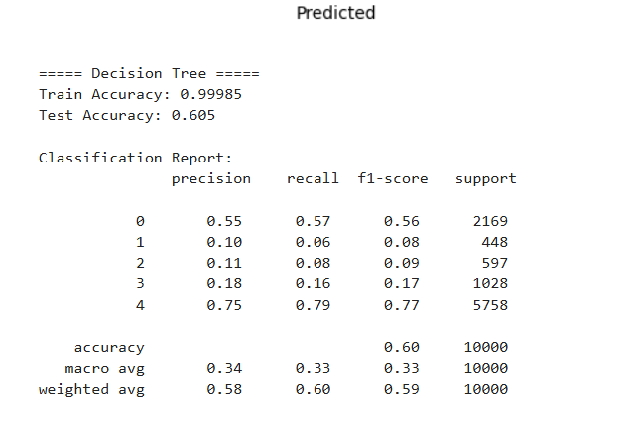
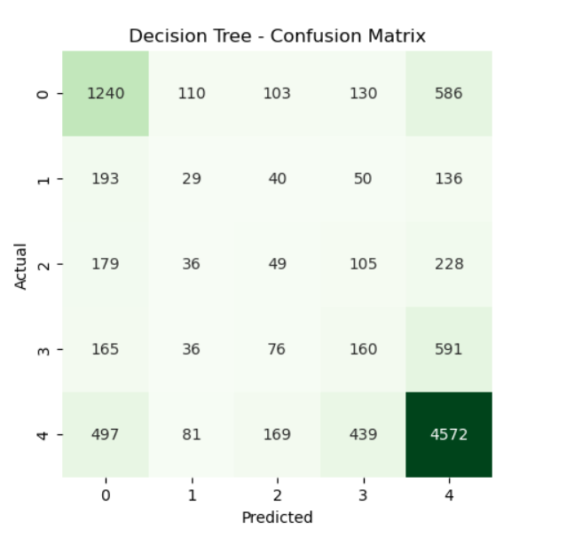
MODEL EVALUATION – DECISION TREE

Slide 9
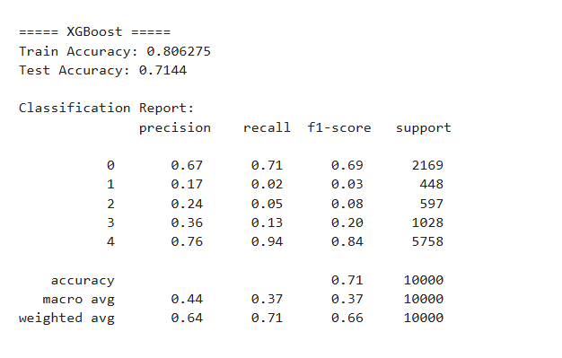
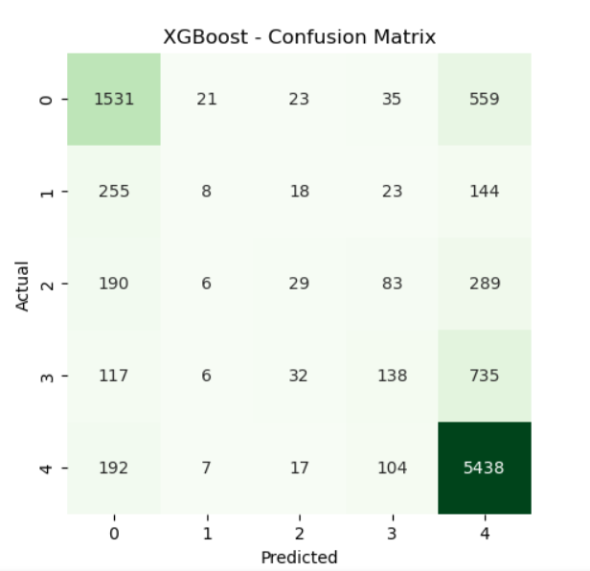
MODEL EVALUATION – XGBCLASSIFIER

Slide 10
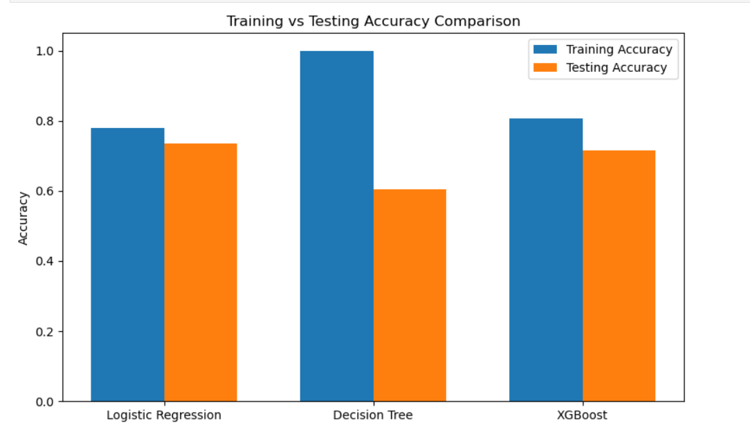
Training Vs testing accuracy comparison

Slide 11
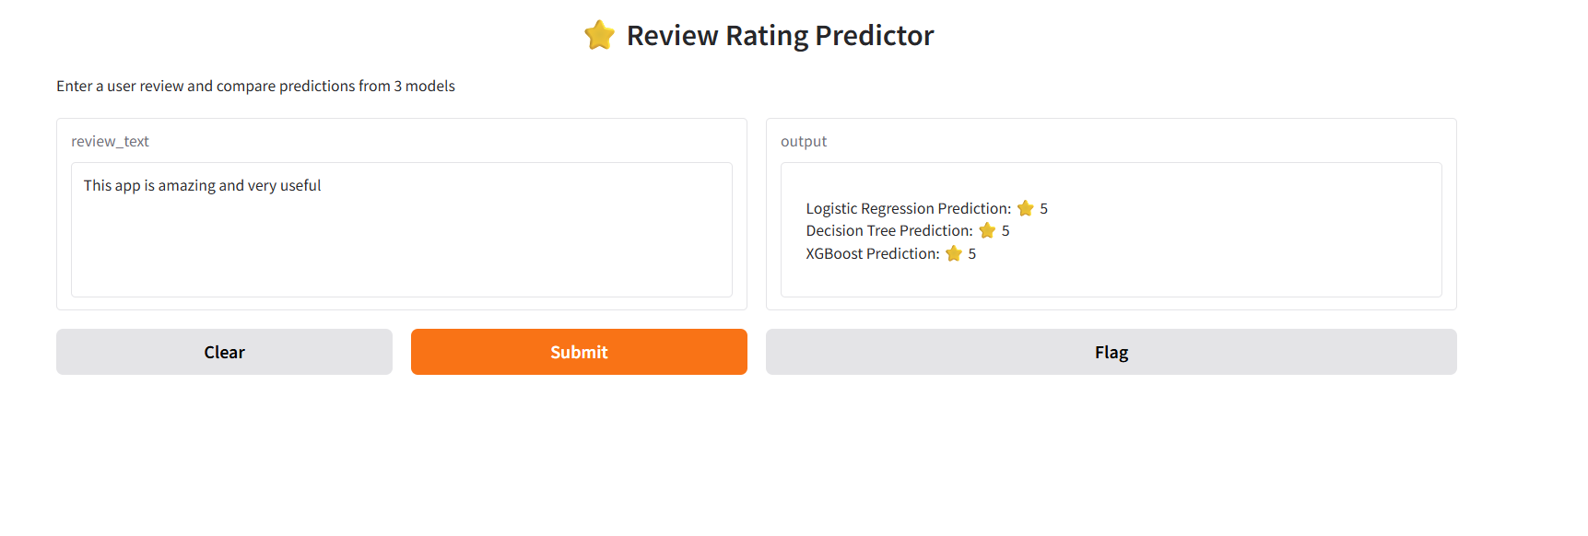

Slide 12
FUTURE IMPROVEMENTS
Improve accuracy using advanced text features (n-grams, stopword removal)
Apply hyperparameter tuning for better model performance
Use deep learning models (LSTM, BERT) for better text understanding
Handle class imbalance in ratings
Add sentiment analysis alongside rating prediction
Deploy the system as a web or mobile application
Enhance UI with better visualization and user experience

Slide 13
KEY INSIGHTS AND FINDINGS
Text reviews can effectively predict user ratings using ML models
TF-IDF successfully converts text into meaningful numerical features
Logistic Regression performs well as a strong baseline for text data
Decision Tree tends to overfit (high training, lower testing accuracy)
XGBoost provides the best overall performance and generalization
Model comparison helps identify the most reliable approach
Interactive tools like Gradio make predictions accessible in real time
Proper preprocessing and data handling significantly impact accuracy

Slide 14
CONCLUSION
Successfully built a system to predict star ratings from user reviews
Applied machine learning models on text data using TF-IDF
Compared multiple models to evaluate performance
XGBoost achieved the best overall results
Demonstrated importance of proper preprocessing and model selection
Developed an interactive interface using Gradio for real-time predictions
The system can help businesses understand user feedback efficiently

Slide 15
THANK YOU

